Slide 1

Instagram User Data Analysis
Presented by:-Pranjul Shrivastava
Date:-28/10/24

Slide 2
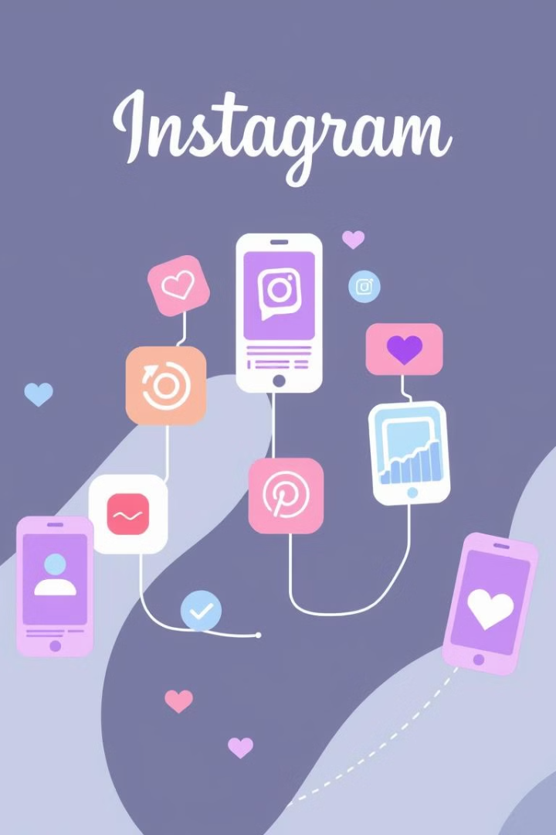
About Instagram:-
Instagram is a visual-centric social media platform founded in 2010, focusing on sharing photos and videos. Acquired by Facebook (now Meta Platforms, Inc.) in 2012, it has rapidly grown to become one of the most popular social networking sites globally, boasting over 1 billion monthly active users.

Slide 3
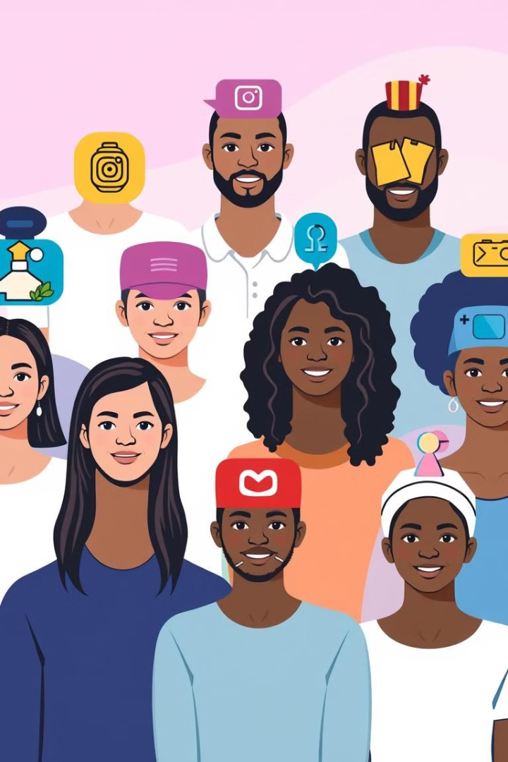
Problem Statement:
The Meta Marketing team aims to harness Instagram's user data to formulate targeted marketing strategies that will enhance user engagement, boost retention rates, and drive customer acquisition. By analyzing user interactions and preferences, we can craft personalized experiences that resonate with our audience. This approach will not only strengthen our brand presence but also foster deeper connections with users, ultimately leading to sustainable growth.

Slide 4
Data Overview
Summary of Dataset:-
The dataset contains seven tables: photos, comments, likes, follows, tags, and photos_tags.
The data illustrates user engagement levels on Instagram, encompassing photos shared by users, comments on these posts, tags, likes, and associated hashtags.
The data also captures a detailed timeline, showing when photos were posted, the timing of likes and comments, and the specifics of associated hashtags.
Significance of Data:-
By examining likes, comments, and follows, it helps identify the factors driving engagement and popularity of certain posts or accounts.
By analyzing which photos, tags, and interactions are most popular, it supports targeted content creation that resonates with users.
The comprehensive view of user behavior and engagement dynamics can help refine strategies for user retention, content scheduling, and increasing overall platform engagement.

Slide 5
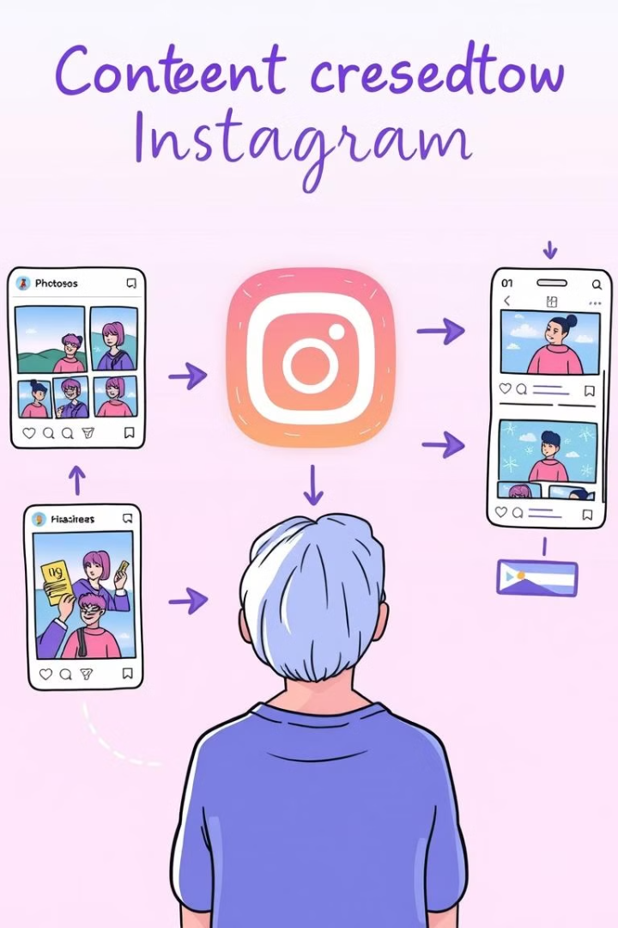
Methodology
Conducted a thorough check for duplicate and null values across all seven tables to ensure data integrity.
Applied aggregate functions such as ‘sum’, ‘count’ ‘average’ to calculate various engagement levels among users on the platform
Utilised ‘JOINS’ ‘CTE’ to identify popular users based on their comments, photos, likes and hashtags and inactive users as well.

Slide 6
Activity level of Top Users
It shows the top 10 users based on the engagement rate, taking into account their posts, the number of likes and comments they have received.
It is helpful in selecting the influencer or the brand ambassador for promotions

Slide 7
Followers of Top 10 users
The graph is showing the count of followers of top 10 users.
High follower counts among the top users indicate their potential as influencers.

Slide 8
Popular hashtags
Identified the top 10 hashtags that receive the highest average number of likes.
This insight will help guide hashtag selection for ad campaigns, ensuring alignment with audience preferences and maximising engagement potential.

Slide 9
Demographic influence on content
This illustrates the peak engagement hours across various age groups, locations, and genders.
These insights will guide content creation tailored to specific demographics and locations, ensuring timely and more impactful responses from each audience segment.

Slide 10
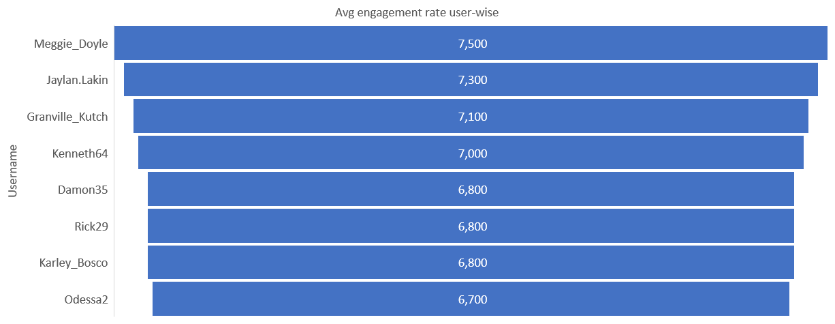
Engagement rate of Users
Engagement rate helps pinpoint high-engagement users for collaborations, ensuring campaigns are more impactful and reach active followers.
High-engagement users often maintain regular interactions, increasing the likelihood of spreading brand messages organically and boosting credibility.

Slide 11
Popular Content based on comments, likes and tags_count
These are the popular contents that have highest number of likes, tags, comments this will help on creating ads and promotions on these contents
Boost engagement by sharing user content that naturally highlights these popular themes

Slide 12
Inactive Users: Who never liked any post
user_id | Username
1 | Kenton_Kirlin
7 | Kasandra_Homenick
23 | Eveline95
25 | Tierra.Trantow
29 | Jaime53
34 | Pearl7
45 | David.Osinski47
49 | Morgan.Kassulke
This is the list of user who never liked any post to enhance reach and engagement, we aim to encourage more active participation from these users
Implementing rewards and special incentives could help motivate these inactive users to engage more frequently,

Slide 13
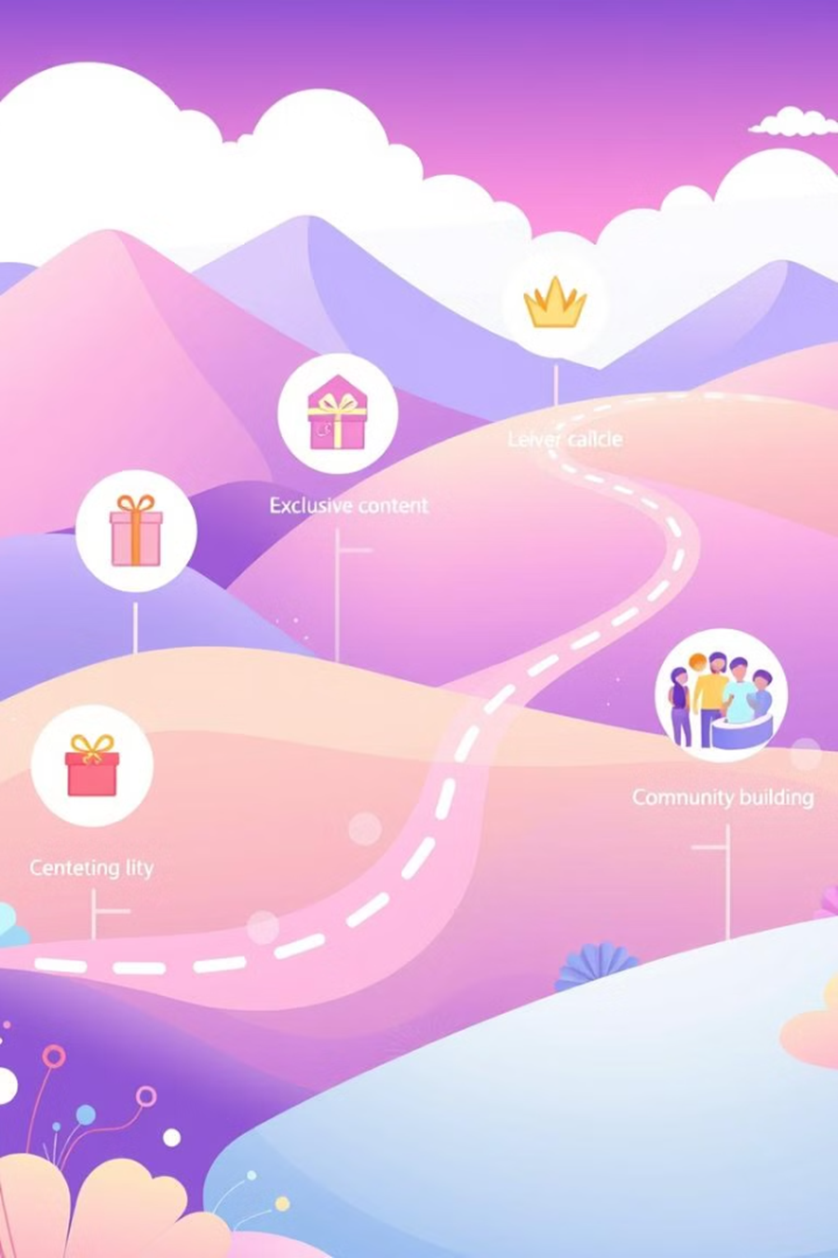
Recommendation 1
Content:-
Smile, Beach, Party, Fun, Food, Concert has highest comments, likes and tags count content around these contents will boost engagement by users
Ads featuring these themes can boost the reach among audiences interested in lifestyle and leisure
Hastags:-
Popular hashtags like #Photography, #Landscapes, #Beach, and #Stunning are highly effective for expanding reach and attracting a broader audience.
Using these hashtags, along with niche-specific tags, can enhance visibility and drive engagement among users interested in similar content themes.

Slide 14
Recommendation 2
Selection of Influencer/Brand Ambassador:-
Meggie_Doyle, Jaylan.Lakin, Granville_Kutch, have the highest engagement rate among other followers
High-engagement users often maintain regular interactions, increasing the likelihood of spreading brand messages organically and boosting credibility.
Rewards/ Inceintive to Inactive users:-
Enter active users into a monthly raffle to win rewards such as gift cards, brand merchandise, or premium subscriptions.
Create a points system or badges for engagement (likes, comments, shares) that users can redeem for perks like profile customization, exclusive filters, or even discounts with partner brands

Slide 15
Conclusion
Content centered around popular themes like "Smile, Beach, Party, Fun, Food, and Concert" resonates well with audiences, making it ideal for both organic posts and targeted ads to attract lifestyle and leisure-focused users. Incorporating top-performing hashtags (#Photography, #Landscapes, #Beach, and #Stunning) will further enhance visibility, tapping into a broader audience interested in these themes. Collaborating with high-engagement influencers such as Meggie_Doyle, Jaylan.Lakin, and Granville_Kutch will amplify our reach authentically, as their strong follower interactions increase credibility and encourage organic sharing. Finally, implementing rewards and incentives like raffles and a points-based system will re-engage inactive users, motivating them to participate more frequently.

